Slide 1
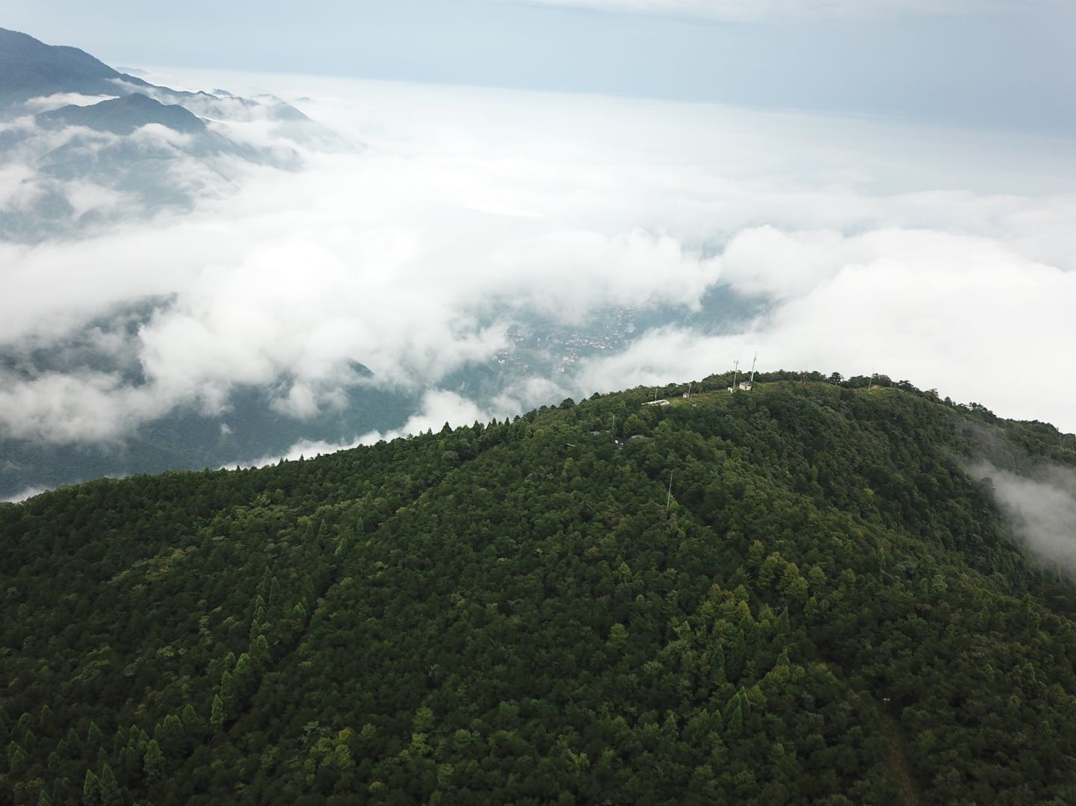
Detection of forest canopy gaps from UAV aerial images: Comparison of four methods based on photographic height, spectrum and texture information
Reporter: Jiale Chen
May.3 2020

Slide 2
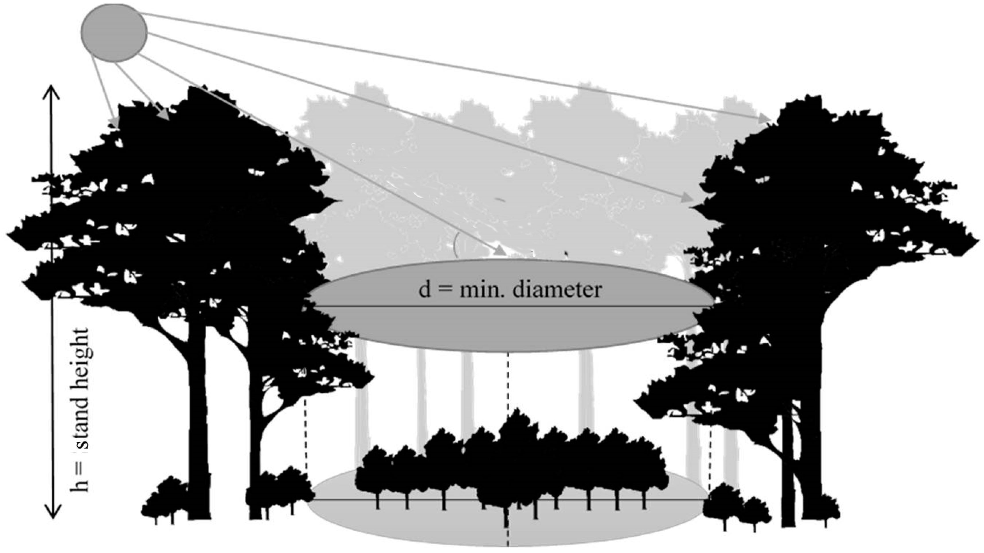
BACKGROUND
Gap characteristics : size, shape, age, maximum height of the surrounding , Maximum solar angle, orientation ,topographic…
Definition: A gap is a “hole” in the forest extending through all levels down to an average height of 2 m above ground（Brokaw 1982）.
Canopy gap characteristics
Emergent layer
Understory resource allocation
canopy layer
Canopy gap
Understory layer
Significance:(1)understanding species coexistence, ecosystem dynamics, species diversification and distribution.(Bonnet 2015)
(2) to promote a nature-based silviculture, by emulating natural disturbances.(Stiers 2019)
Maintain
biodiversity
Forest floor
Soil
Influencing forest structure, tree recruitment and regeneration success, forest composition.(white 2018) ,
Understory resource: light availability(Hubbell 1999), soil nutrient ,soil moisture.(Ediriweera. 2011),
Notes:
传统的森林生物多样性测量主要基于实地物种的清查。然而，由于劳动力密集和耗时的实地测量，缺乏树种丰富度的时空分布信息，极大地阻碍了对森林生物多样性的理解。遥感技术越来越多地用于多空间尺度的森林生物多样性监测。

Slide 3
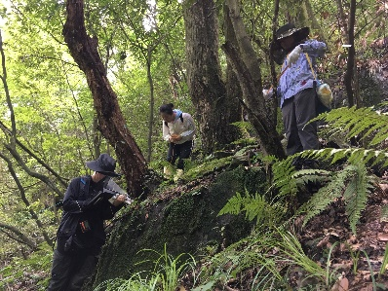
BACKGROUND
Field inventory
Time-consuming and laborious, occasional errors , limited to the plot scale.
methods
information
flaws
Object based image analysis
Spectral information, texture features, geometric shapes
Object segmentation process is difficult and requires a large number of samples.(Nyamgeroh 2018)
information
Spectral information
How to accurately detect canopy gaps?
Pixel-based supervised classification
Remote sensing
Spectral information
Spectral information
Unable to distinguish between sapling in the canopy gap and surrounding canopy
Airborne laser scanning (ALS)
Lack of time series data, Limited data availability
(Nuske .2019)
CHM（canopy height model）thresholding
Spectral information
Digital aerial photogrammetry (DAP)
Result Influenced by forest height and shadow
(Nuske .2019)
Spectral information
Notes:
传统的森林生物多样性测量主要基于实地物种的清查。然而，由于劳动力密集和耗时的实地测量，缺乏树种丰富度的时空分布信息，极大地阻碍了对森林生物多样性的理解。遥感技术越来越多地用于多空间尺度的森林生物多样性监测。

Slide 4
Questions & Hypotheses
1.Is there a method based on data fusion, using the aerial image spectrum, texture and DAP height information to detect the forest gap? Compared with other three methods based on aerial images, whether this method can significantly improve the accuracy of forest gap detection?
We hypothesis that such a method exists and can significantly improve the accuracy of forest gap detection.
2. For the gaps of different size levels, topography, and forest age, are the detection results of the four methods significantly different?
There are significant differences between the four methods, and the method based on spectrum, texture and height information is better
3. Is there a significant bias in characterization of canopy gap between the remote sensing methods and the traditional ground inventory?
There is no significant bias between the two methods.
Notes:
成像光谱和激光雷达(光探测和测距)已经成为预测物种丰富度的强大工具，甚至可以在不同的生态系统中识别单个植物物种
激光雷达数据显示了捕捉冠层结构特征的巨大潜力，包括叶面积指数(LAI)和树高。此外，它们还被发现用于分离单个树冠(ITCs)
通过提供物种结构多样性以及宏观或微观地形特征的信息，激光雷达显示出了区分物种群落或估计物种丰富度的一些潜力.

Slide 5
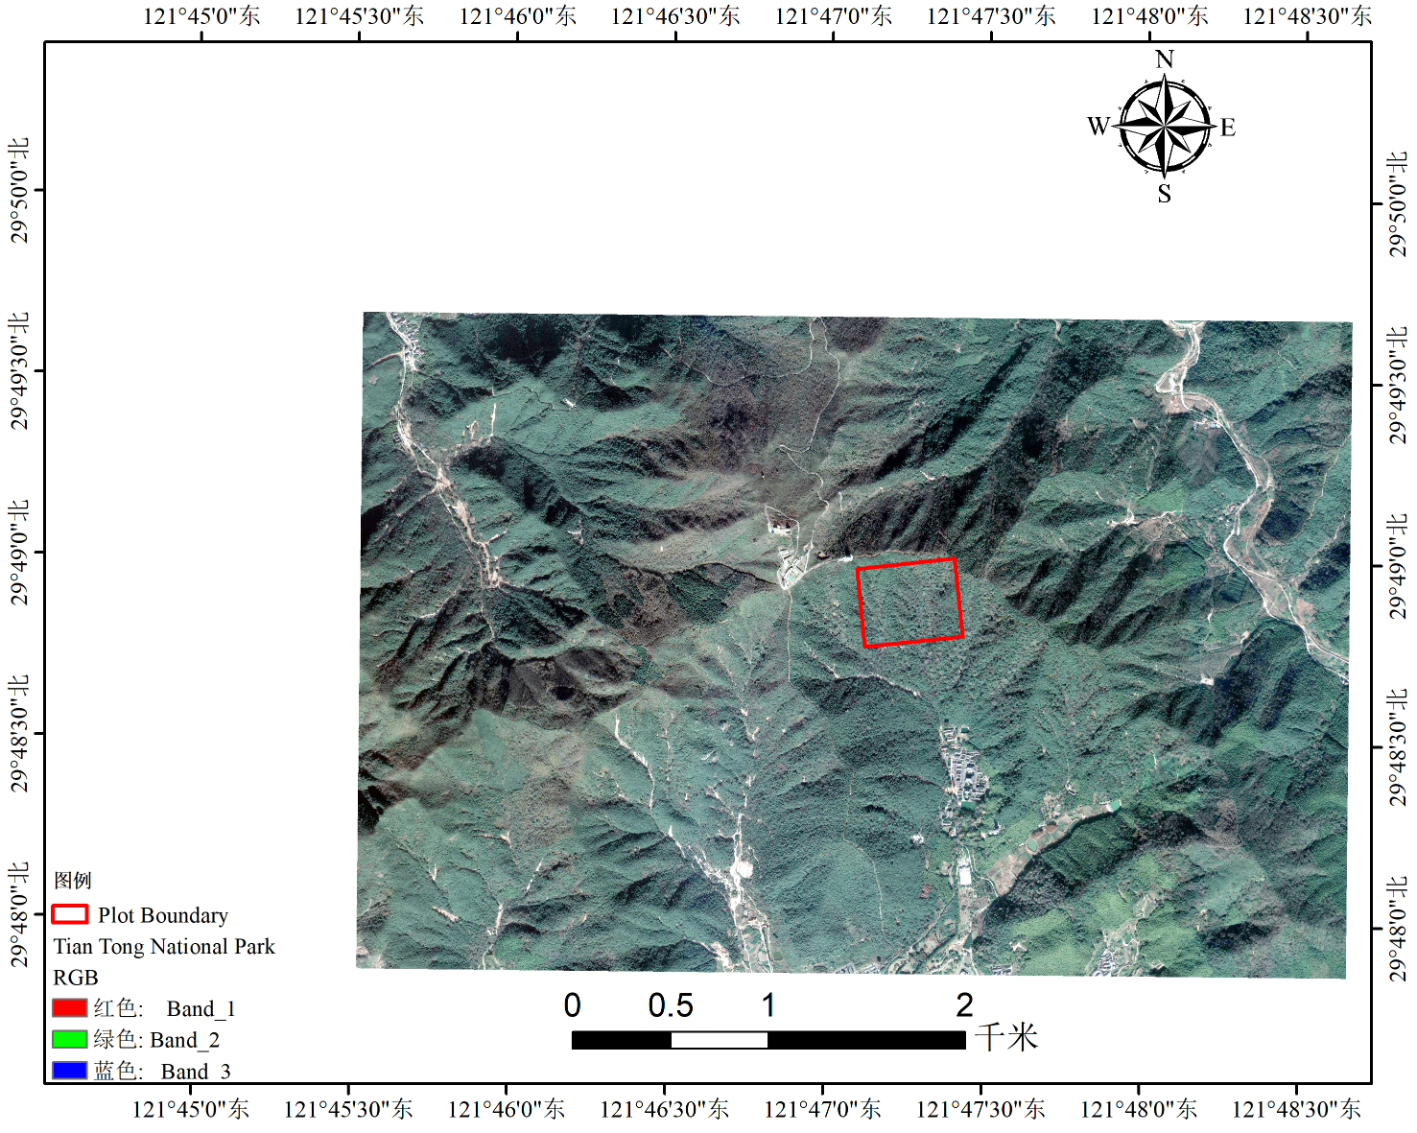
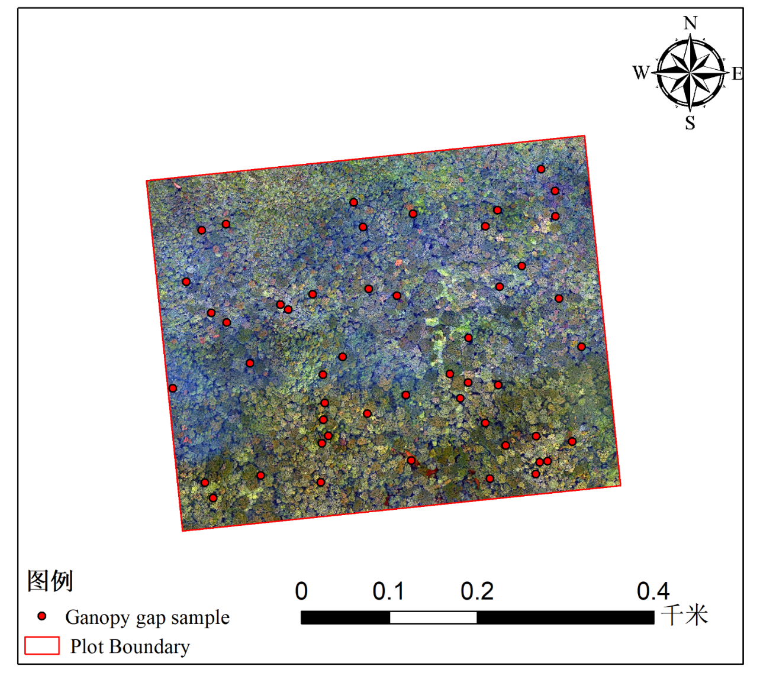
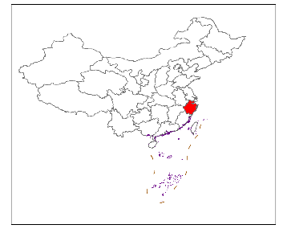
Study site
The 20 ha permanent plot of forest ecosystem in the TianTong National Park (Zhejiang Province, China)
(29°48． 696'—29°48． 938' N， 121°46． 953'—121°47． 278' E, from 304m to 602m above sea level)
Notes:
研究区面积约117km2 它是世界中纬度地区唯一一个完整的亚热带森林生态系统，植物种类十分丰富。选择一个几乎覆盖所有优势种和海拔梯度的物种复杂典型区域(3.5km×3km)进行模型建立和验证(图1) 研究区域的森林冠层由大约20种优势树种组成.

Slide 6
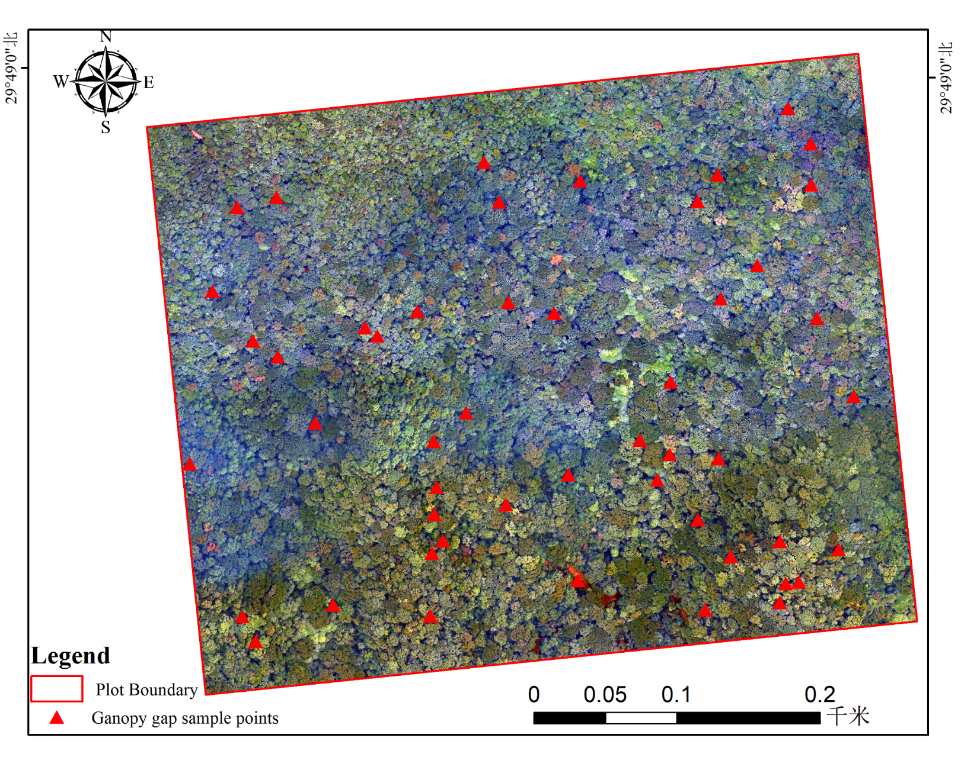
Field Data
A total of 50 canopy gap sample points within the 20 ha plot.
Direct evaluate the detect result of four methods

Slide 7
Field Data
Twice comprehensive field inventory of canopy gap in 2010 and 2015 within the 20 ha plot
2010 (张志国）
2015（林庆凯）
the overall characteristics: There are 174 canopy gaps,
the total area is 23980.87 m² , maximum area of canopy gap is 664.04 m²,and minimal is 46.18 m², gap area fraction is 13.1%, canopy gap density is 9.5/ha.
the overall characteristics: There are 149 canopy gaps,
the total area is 7504.18 m², the average area is 50.36 m² maximum area of canopy gap is 223.9m², and minimal is 15.6 m², gap area fraction is 3.8%.
Canopy gap Type | range | Gap number | Gap area/m²
Small | 45~100 | 74 | 5750
medium | 100~250 | 85 | 12000
Large | >250 | 15 | 6230.87
Canopy gap Type | range | Gap number | Gap area/m²
Small | 15~50 | 104 | 3337.32
medium | 50~100 | 22 | 2256.67
Large | >100 | 13 | 1910.20

Slide 8
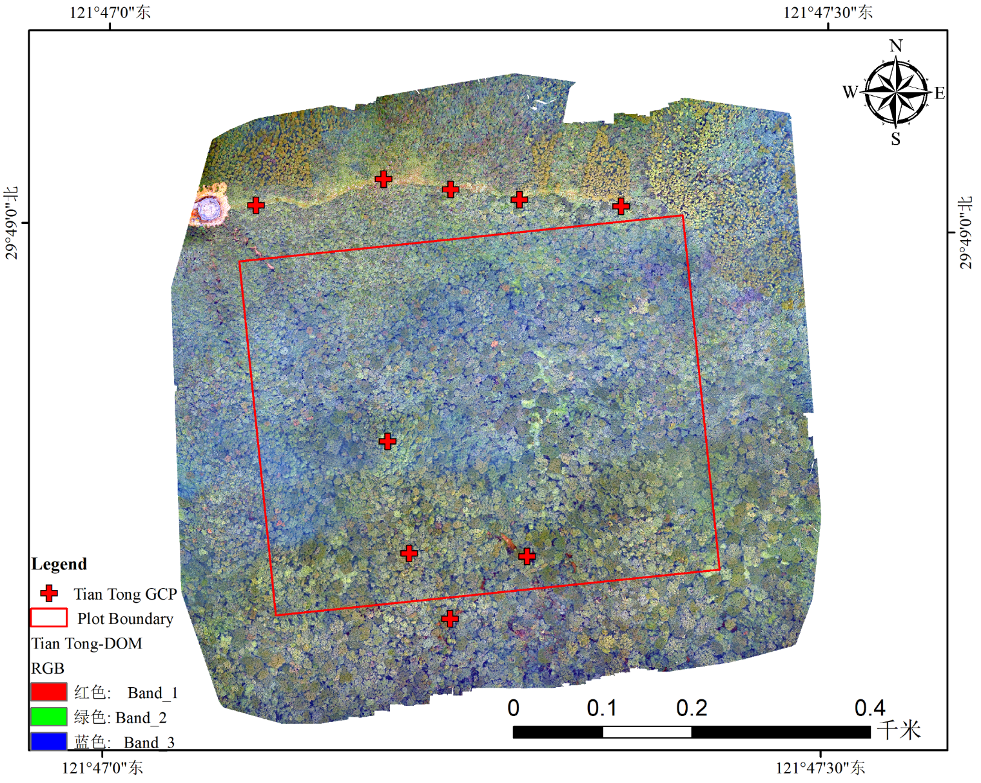
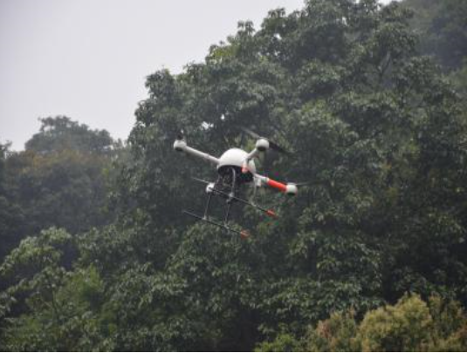
UAV Data
In September 2016, the German MD4-1000 UAV was used as a platform, equipped with RGB camera to obtain aerial images. The flight height was 240m, the flight speed was 5m / s, and 9 GCPs were placed on the ground. 312 photos were taken.

Slide 9
UAV Data
DEM
Field Data
Flow chart
Pixel-based supervised classification
Object based image analysis
CHM thresholding
Automatic classification based on photographic height, spectrum, texture
Direct evaluation based on 50 forest gap sampling points
Compared with field inventory data on overall canopy gap characteristics
Compared the result of four methods in different canopy gap size, topographic, forest age.
The most suitable method to detect canopy gap

Slide 10
03
RESULTS

Slide 11
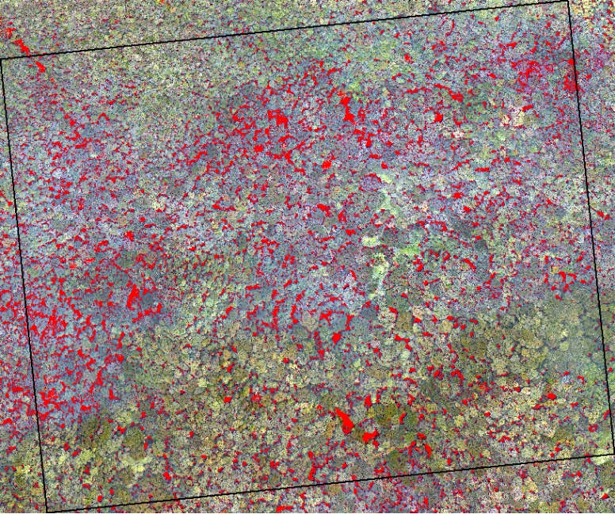
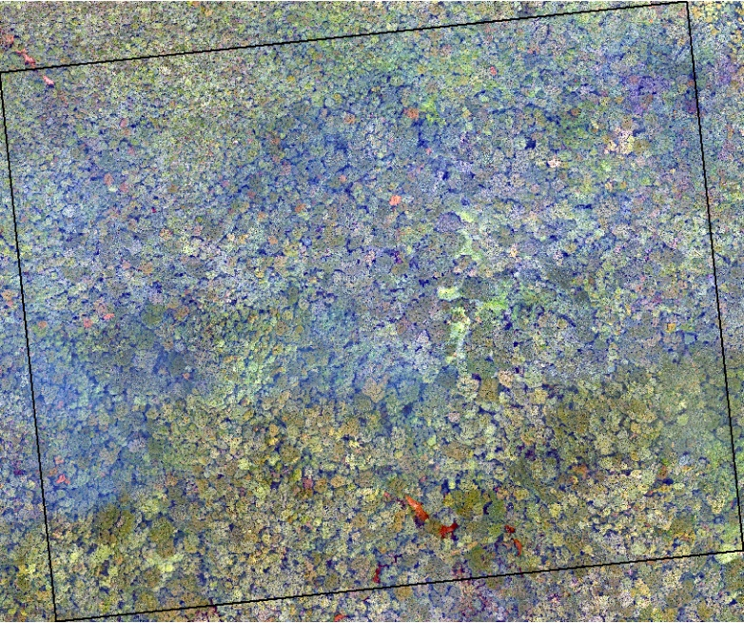
Pixel-based supervised classification
The pixel-based supervised classification uses three classifiers, namely the maximum likelihood method, neural network, and support vector machine. The maximum likelihood method has the highest accuracy, the overall accuracy is 93%, and the Kappa coefficient is 0.90. support vector machine and neural network are 0.88 and 0.85, respectively.
Notes:
使用基于形态学冠控制的分水岭算法从CHM中分离出单个树冠

Slide 12
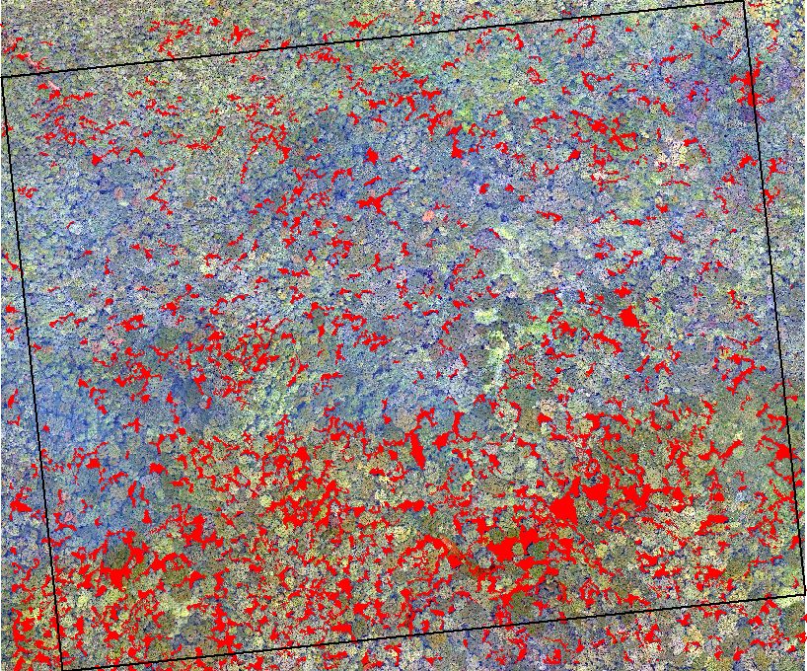
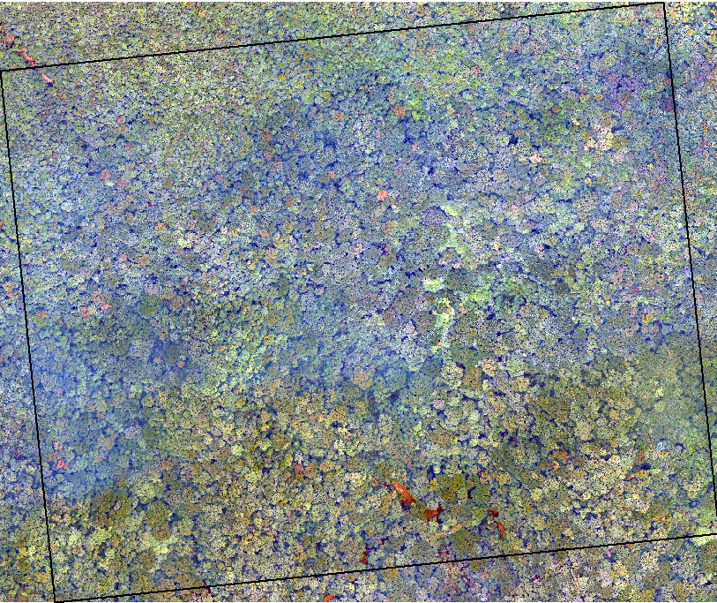
Object based image analysis
Why the overall accuracy lower than supervised classification ?
In the process of Object based image analysis, the optimal segmentation scale is determined to be 30, the weights of the shape index parameter and the compactness index parameter are 0.1 and 0.5, respectively. overall accuracy is 81%, Kappa coefficient is 0.56.
Notes:
（a）和（b）显示了基于33个VIS中每个生化组的基尼重要性排名的RF回归结果。ndni、cri、tcariou osavi[705750]、sr[705750]、pri、ndli和ndwi是各生化组最重要的预测VIS，且在所有情况下其相互关系均小于0.85。从而确定了它们是指示N、Car、Chl、Sla、Xan、配体EWT的最佳生化VIS。

Slide 13
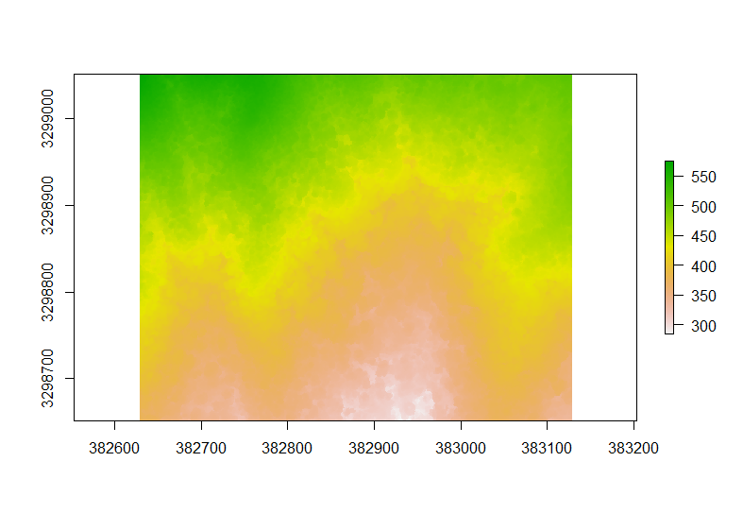
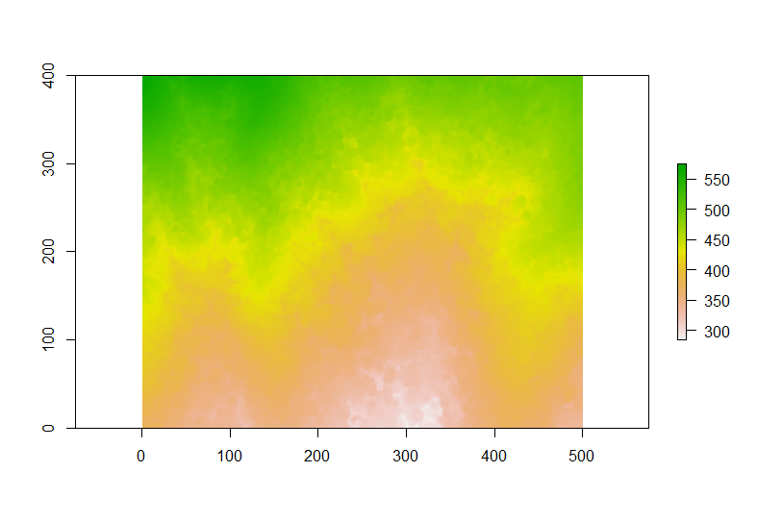
CHM Thresholding
UAV-DSM(raw)
DSM（1m resolution）

Slide 14
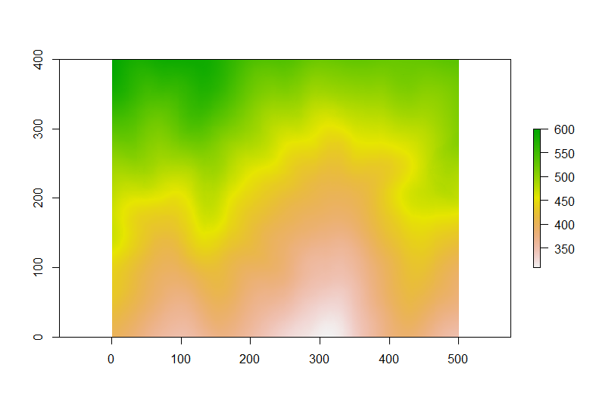
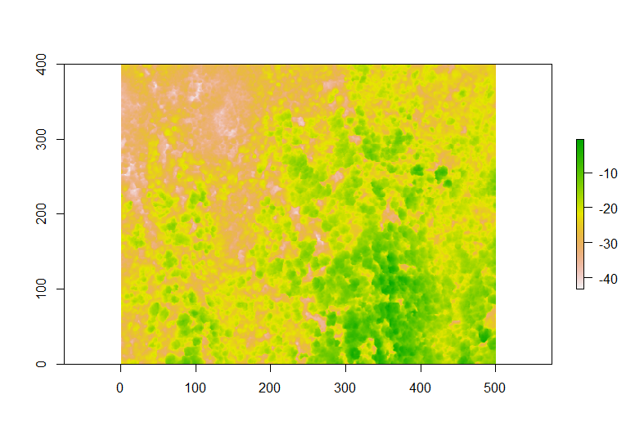
CHM Thresholding
DEM(1m resolution from ground measurement )
CHM=DSM-DEM

Slide 15
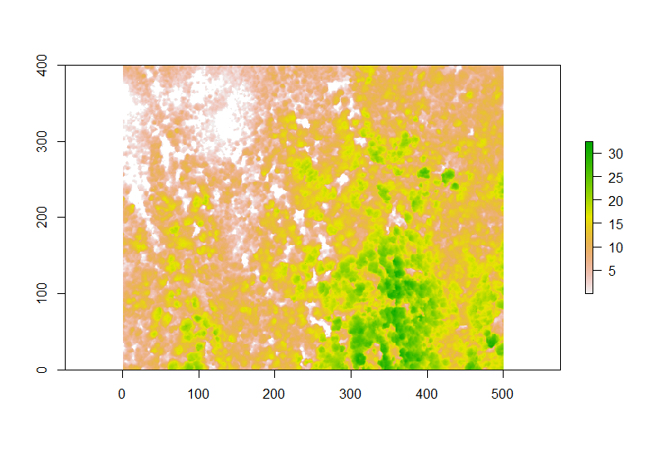
CHM Thresholding
CHM(after correction)
Canopy gap distribution

Slide 16
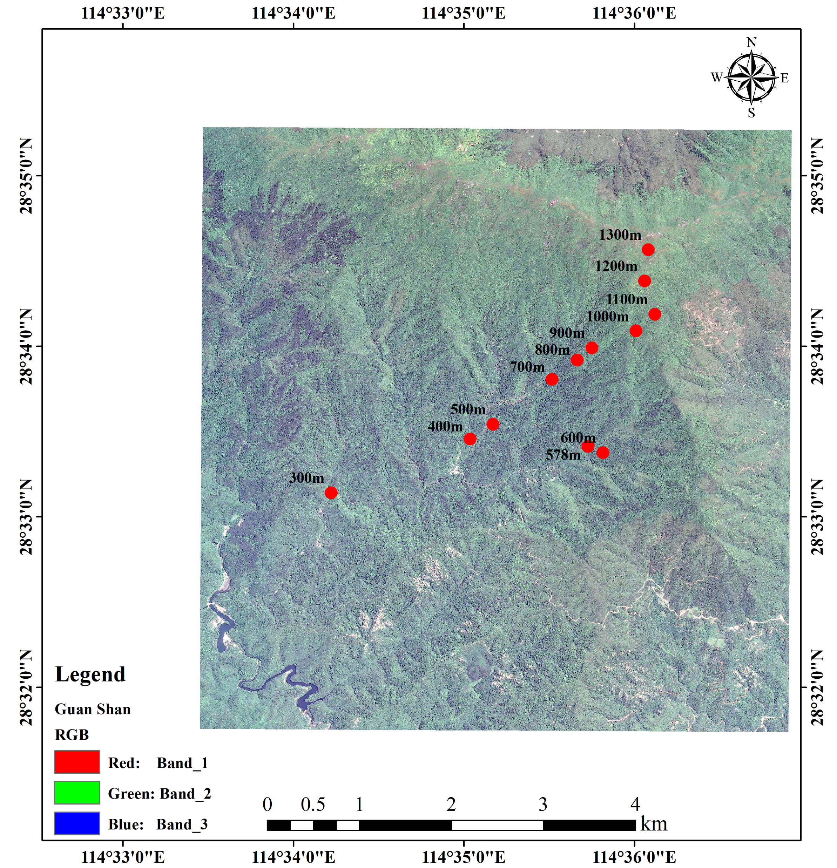
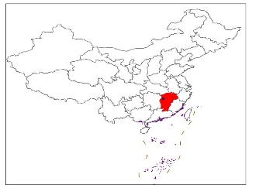
CHM Thresholding

Slide 18
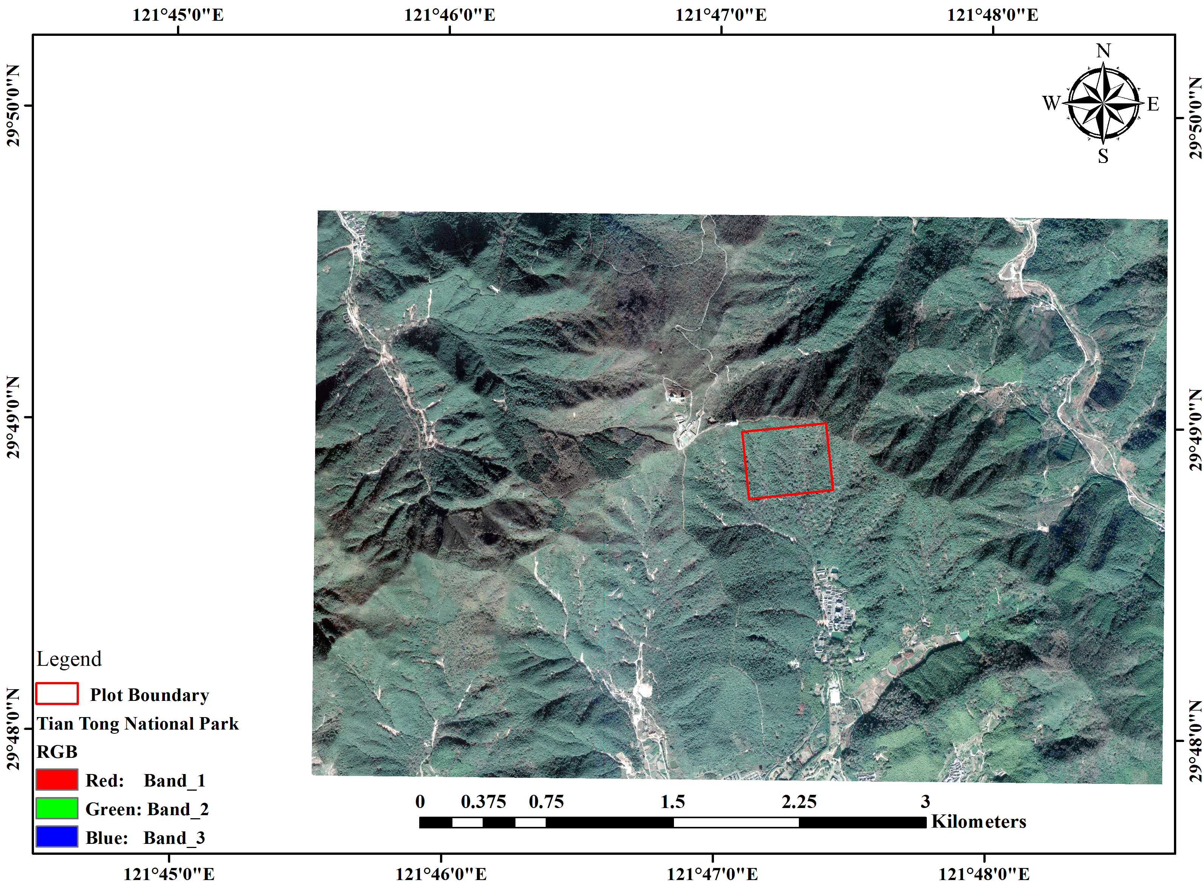
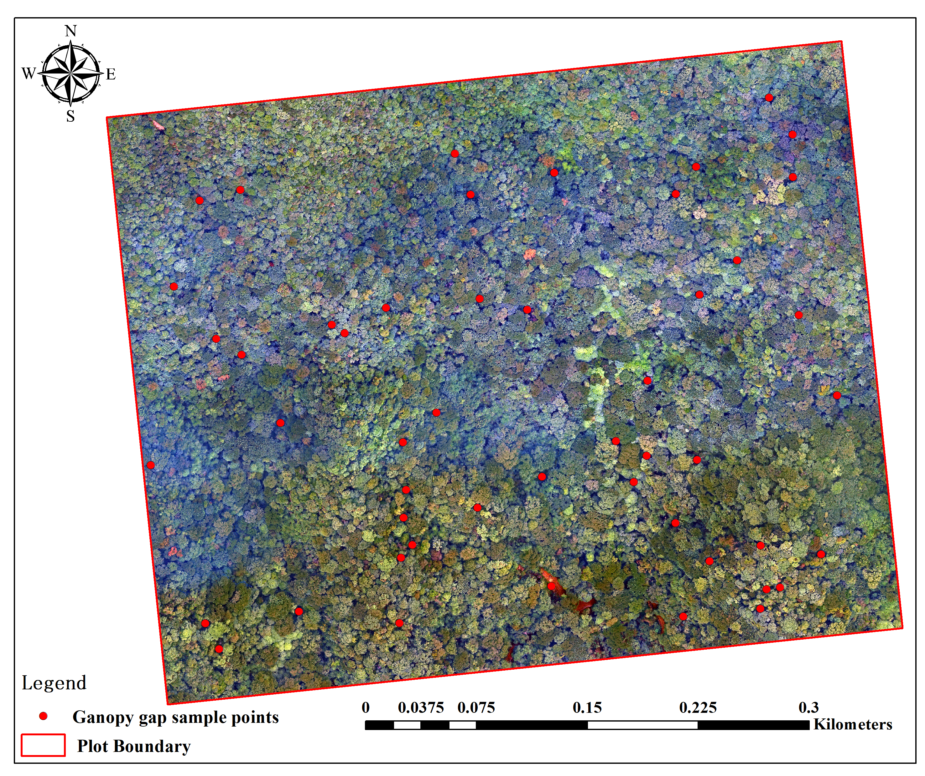
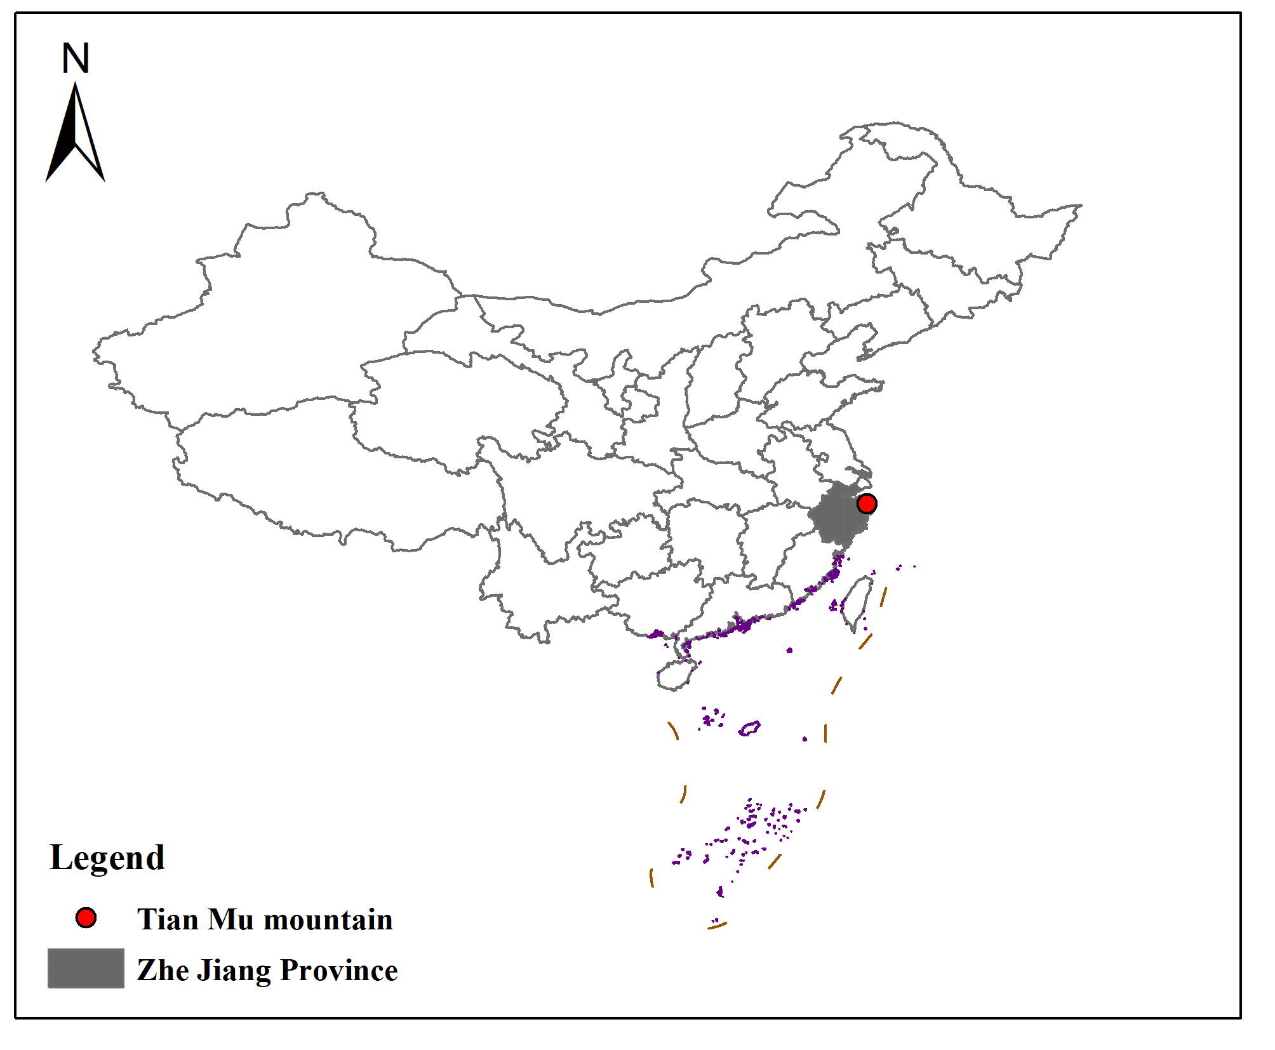
Study site
The 20 ha permanent plot of forest ecosystem in the TianTong National Park (Zhejiang Province, China)
(29°48． 696'—29°48． 938' N， 121°46． 953'—121°47． 278' E, from 304m to 602m above sea level)
Notes:
研究区面积约117km2 它是世界中纬度地区唯一一个完整的亚热带森林生态系统，植物种类十分丰富。选择一个几乎覆盖所有优势种和海拔梯度的物种复杂典型区域(3.5km×3km)进行模型建立和验证(图1) 研究区域的森林冠层由大约20种优势树种组成.

Slide 19
CHM Thresholding
Next work
The validation of CHM thresholding
Automatic classification based on photographic height, spectrum, texture…
Compared with field inventory data on overall canopy gap characteristics
Compared the result of four methods in different canopy gap size, topographic, forest age.

Slide 20


Thank you, any question?

